Slide 1

Developing a Data Warehouse and Business Intelligence System
Business Intelligence and Data Integration DR. Joseph Morabito
Team Members (GROUP-2): Chandana Neerubhavi Yeshwanth Satyadev Yedla Jahnavi Enuganti Sai Narasimha Akhil Jillalla

Slide 2
Contents
Company Profile
Business Dimensional Lifecycle
High Level Bus Matrix
Opportunity Matrix
Prioritization Grid
Detailed Bus Matrix
Dimensional Modeling – Steps
Logical Fact Table Diagram
Detailed Fact Table-Team Performance
High Level Model Diagram
Aggregate Table
Dimensions Attribute Detailed Diagram: Season Details
OLAP Cube Design
Analytical Dashboard Using Tableau
User/Task Analysis
Reference
Detailed logical Fact table
Dimensional Table Description
Slicing and Dicing

Slide 3

Company Profile
High Level Enterprise Data Warehouse Bus Matrix
The National Basketball Association (NBA) is a professional basketball league in North America, consisting of 30 teams (29 in the United States and 1 in Canada). It's one of the major professional sports leagues in the United States and Canada and is considered the premier men's professional basketball league in the world.
The league was founded in New York City on June 6, 1946, as the Basketball Association of America (BAA). It changed its name to the NBA in 1949 after merging with the National Basketball League (NBL). The NBA's regular season typically runs from October to April, with each team playing 82 games. The playoffs extend into June, culminating in the NBA Finals.
The NBA is renowned for its star athletes, global fan base, and dynamic gameplay. It has been a pioneer in sports innovation, adopting features like the three-point line and a fast-paced style that emphasizes skill and athleticism.
Notes:
Client needs help in managing its human capital as an example
Consultant goes to client to better understand client needs and then propose a solution and at this stage place initial contract.
After negotiations a contract will be assigned to the Client/Account which can then be broken down to many projects
A Relationship manager will handle the Client as a whole, and a project manager is responsible for individual projects.

Slide 4
Company Profile
The NBA is also an active member of USA Basketball (USAB), which is recognized by FIBA (the International Basketball Federation) as the national governing body for basketball in the United States. The league's influence extends beyond the borders of the U.S. and Canada, with numerous international players contributing to its teams and a massive global following.
The league has also been at the forefront of social justice issues, allowing its players to use their platforms to advocate for change. The NBA Cares program is the league's global community outreach initiative that addresses social issues, and NBA players are known for their engagement in philanthropic and educational activities.
Moreover, the NBA has evolved its digital presence to include various online platforms and social media, making basketball and its stars accessible to fans around the world.

Slide 5
Business dimension lifecycle
Business Requirements Definition
Technical Architecture design
Product selection & Installation
Project Planning
Data Stagging Design& Development
Maintenance & Growth
Dimensional modelling
Physical designing
Deployment
Project Planning
Project Planning
Project management

Slide 6
High Level Bus Matrix
Business Process | Player | Team | Game | Season | Arena | Date/Time | Coach
Player Performance | X |  | X | X |  | X | X
Team Performance |  | X | X | X |  | X | X
Ticket sales |  | X | X | X | X | X
NBA Revenue |  | X | X | X | X | X
Team Annual Attendance |  | X | X |  |  | X
Annual League Pattern |  |  | X | X | X | X

Slide 7
Opportunity Matrix
Business Process | Marketing | Sales | Sponsorship & Advertising | Finance
Player Performance | X | X |  | X
Team Performance | X | X |  | X
Ticket Sales | X | X | X | X
NBA Revenue | X | X | X | X
Team Annual Attendance | X | X | X | X
Annual League Pattern | X | X | X | X

Slide 8
Prioritization Grid

Slide 9
Detailed Bus Matrix
Business Process | Fact tables | Granularity | Fact | Date | Player | Team | Game | Season | Arena | Coach
Player Performance | Game-level performance fact table | Per player | Game_ID Player_ID (FK) Team_ID(FK) Points_scored Rebounds Steals Minutes played Fouls Date(FK) | X | X |  | X | X |  | X
Team Performance | Team Game Performance fact table | per game | Team_ID(FK) Season_ID(FK) Points Scored Rebounds Pointes scored Date(FK) | X |  | X | X | X
 | Team Season Fact table | per season | Season_ID(FK) Total_wins Total_loss Total_scored Date(FK) | X |  | X | X | X |  | X
Game Ticket Sales | Ticket sales fact table | Per ticket transaction per game | Number of tickets sold Total sales revenue Average ticket price | X |  | X | X |  | X
NBA Revenue | Total Revenue Fact table | Per team | Season_ID(FK) Total Ticket Revenue Total broadcast revenue Total sponsorship revenue | X |  | X | X | X
Team Annual Attendance | Team Attendance | Per team per person | Total Attendence Capacity utilization Sold out games | X |  | X | X | X | X
Annual League Pattern | Season Summary Fact Table | Per team per person | Total Wins Total Loss Total points scored Total points allowed Playoff appearance | X |  | X |  | X |  | X

Slide 10
Steps to Dimensional Modelling
High Level Enterprise Data Warehouse Bus Matrix
Choose a Business Process and its data
A Business Process is chosen as a Fact Table
Design the DW by the Business Process not the Business Unit
Choose the Grain of the Business Process
Represents one row of the Fact Table
Choose the lowest possible grain, aggregate to higher levels
Choose Dimensions of the Business Process
Dimensions explain Fact tables
Represent Query Entry-Points into the Star Schema
Each Dimension has several Attributes
Choose the measured Facts
Facts are numeric fields that populate each fact table record

Slide 11
Logical Fact table
Season
Player
Date
Arena
Team game performance per game fact table
Grain:
per team per game on team performance
Coach
Total Revenue
Team Attendance
Game day Ticket sales
Game
Team

Slide 12
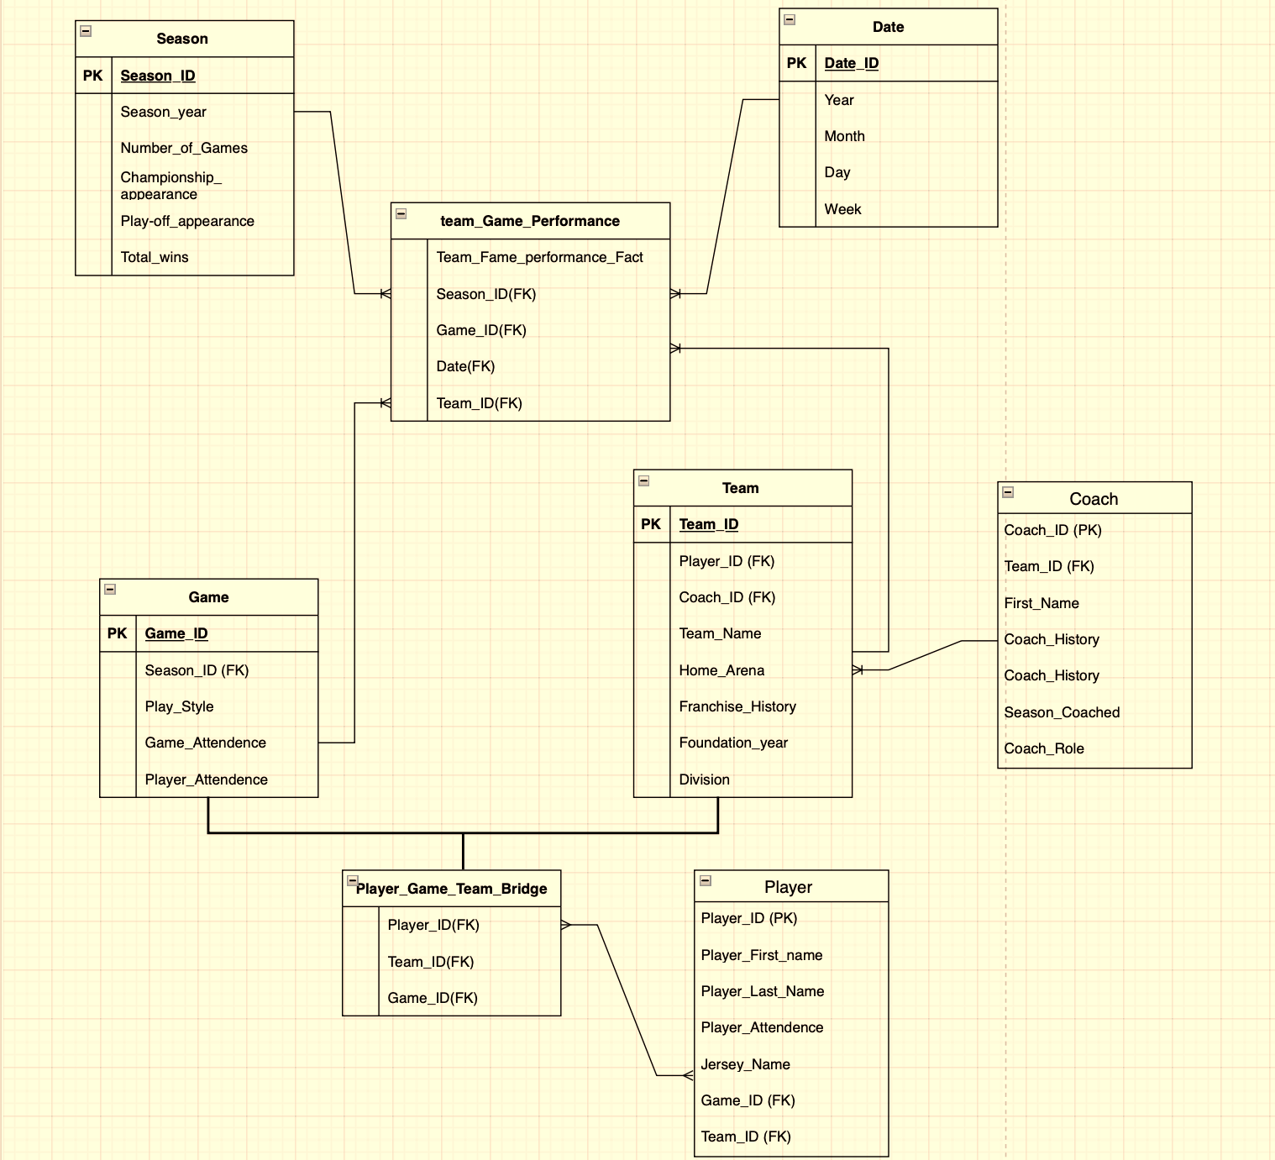
Logical Fact Table

Slide 13
High Level Model Diagram
Season
Date
Team-Game-Performance-Fact
Coach
Game
Team

Slide 14
Detailed Fact Table-Team Performance
Team_Game_Performance_Fact_ID (SK)
Team_Key(FK)
Season_Key (FK)
Date_key (FK)
Game_key (FK)
Facts
Points_Scored_Per_Game
Points Allowed_Per_Game
Rebounds_Per_Game
Steals_ Per_Game
Blocks_ Per_Game
Turnovers_ Per_Game
Dimension Keys - FK Dimensions are the foundation of the fact table and is where the data for the fact table is collected.
The grain of a fact table represents the most atomic level by which the facts may be defined.

Slide 15
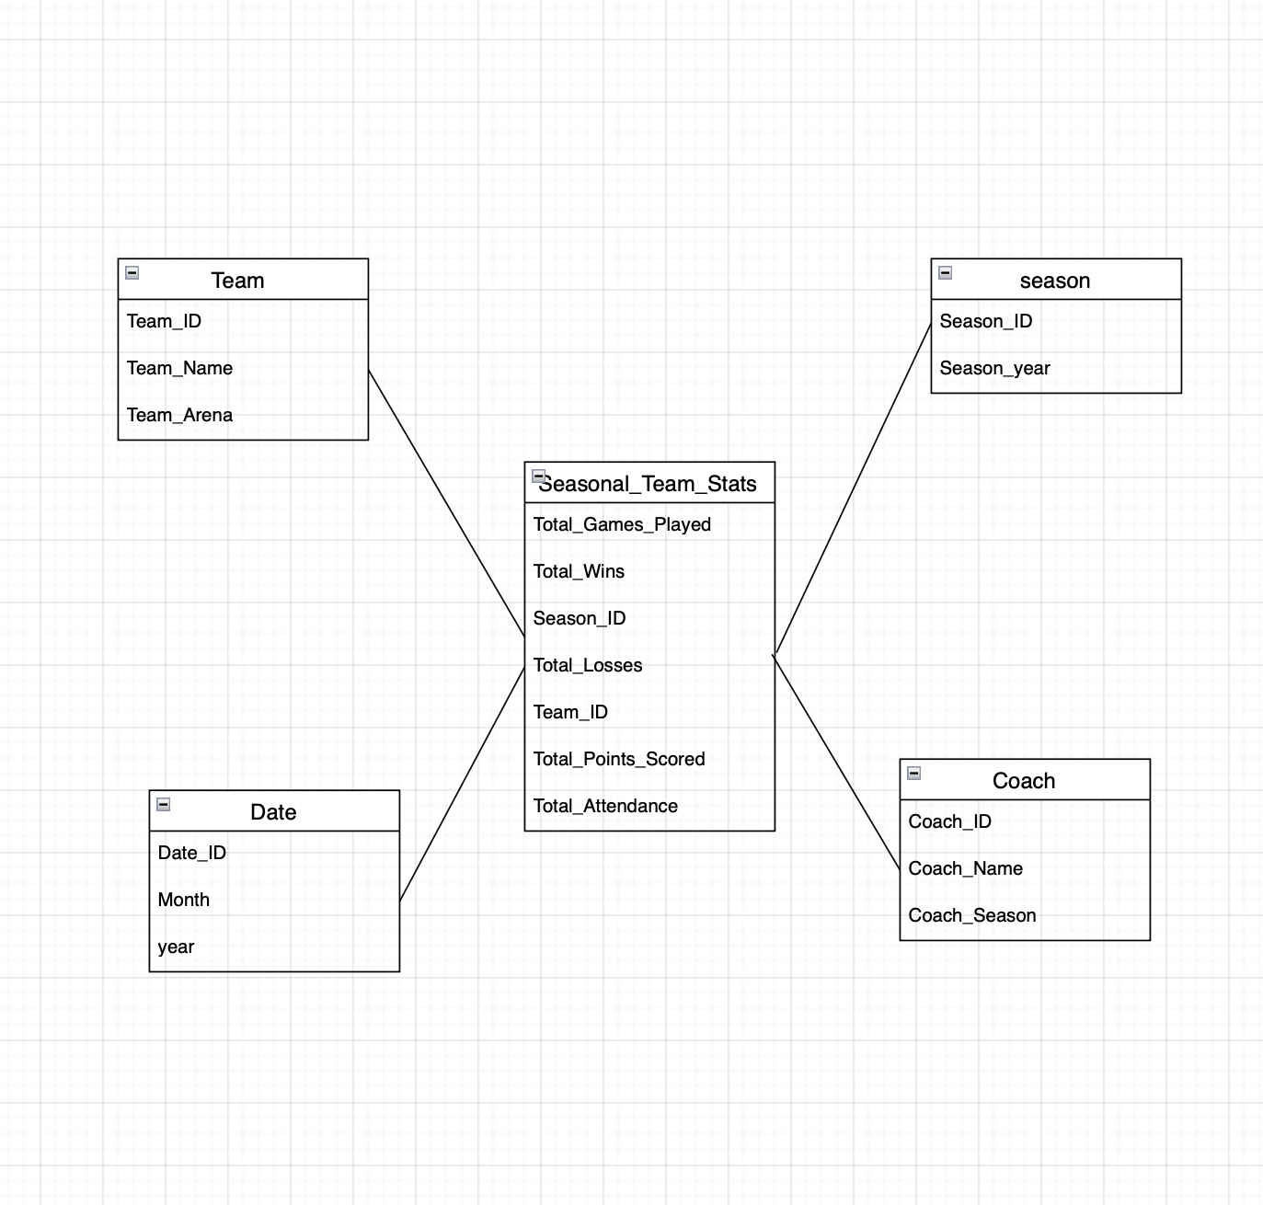
Aggregate table

Slide 16
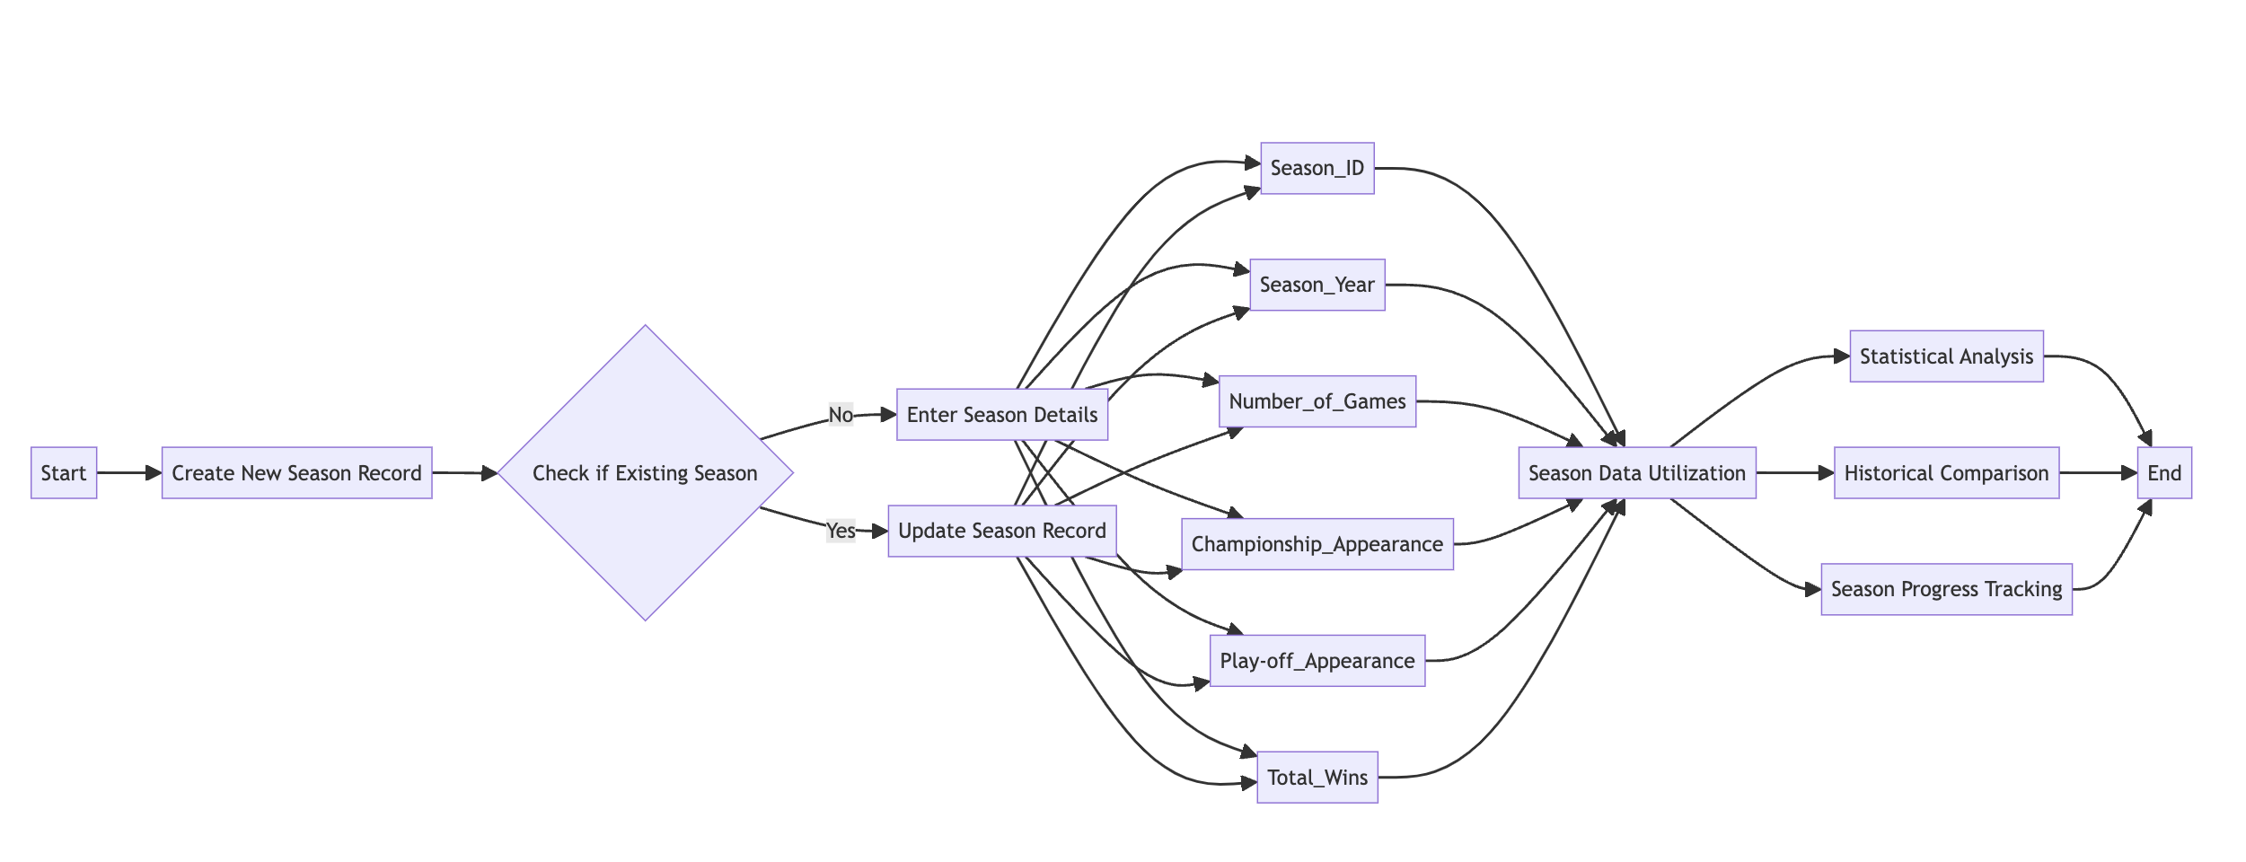
Dimensional Table Detailed Diagram: Season Details

Slide 17
Dimensional Table Descriptions: Season Details
Attribute | Description | Cardinality | SCD Policy | Sample Value
Season_ID | Unique identifier for each season. | High | Type 0 | 'SEAS2024'
Season_year | The calendar year in which the season takes place. | Medium | Type 0/2 | '2024'
Number_of_Games | Total number of games scheduled for the season. | Low | Type 1 | '82'
Championship_appearance | Indicates if the team made a championship appearance. | Low | Type 1 | '1' or 'Yes'
Play-off_appearance | Indicates if the team made a playoff appearance. | Low | Type 1 | 'Yes' or 'No'
Total_wins | The total number of games won in the season. | Medium | Type 3 | '50'

Slide 18
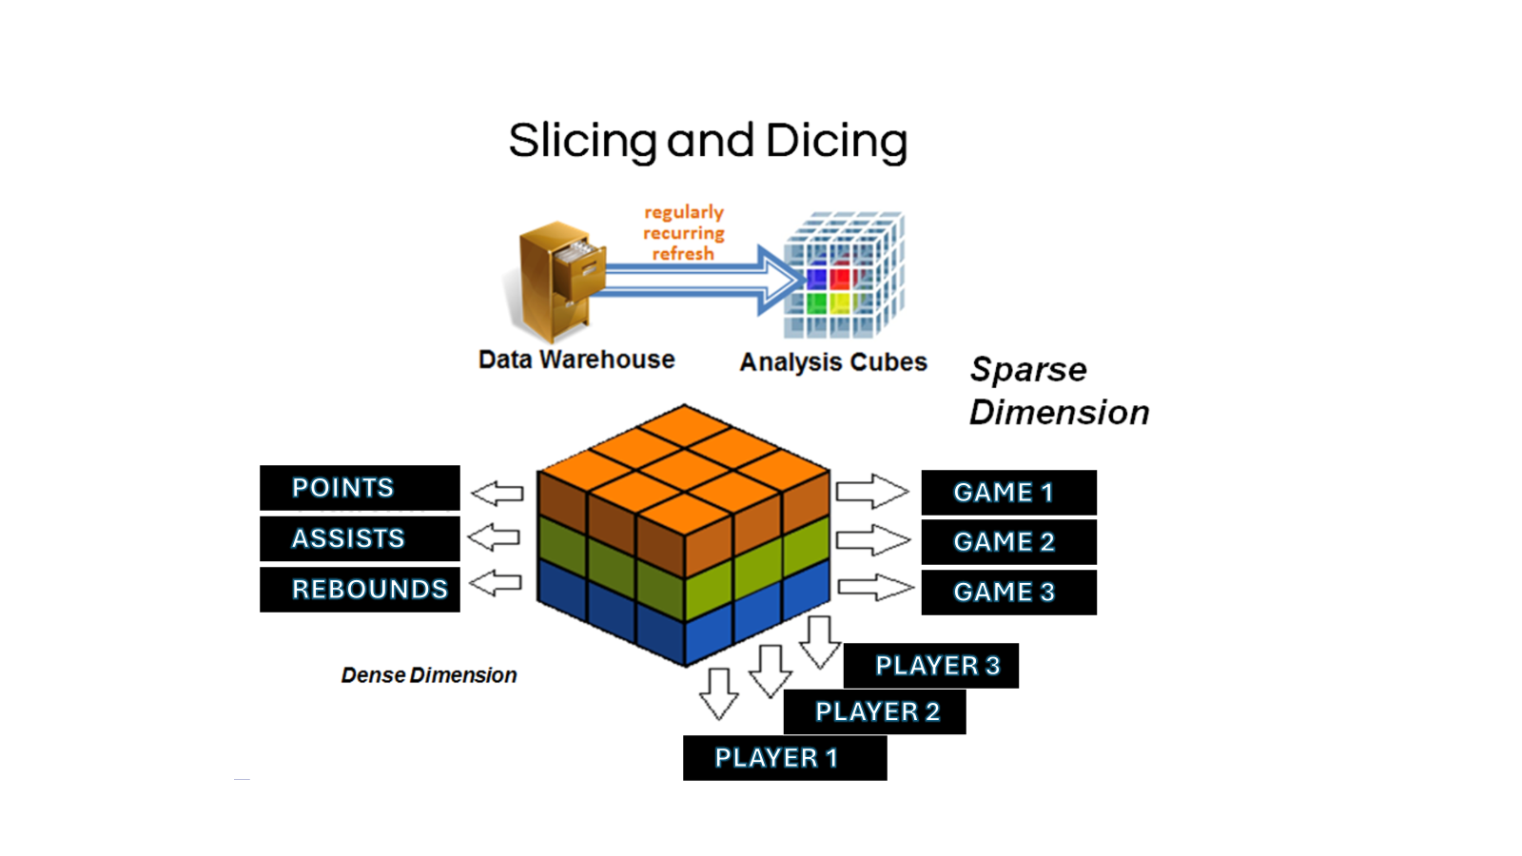
OLAP Cube Design
GPOINTS
GGAME 1
GASSISTS
GGAME 2
GREBOUNDS
GGAME 3
GPLAYER 3
GPLAYER 2
GPLAYER 1

Slide 19
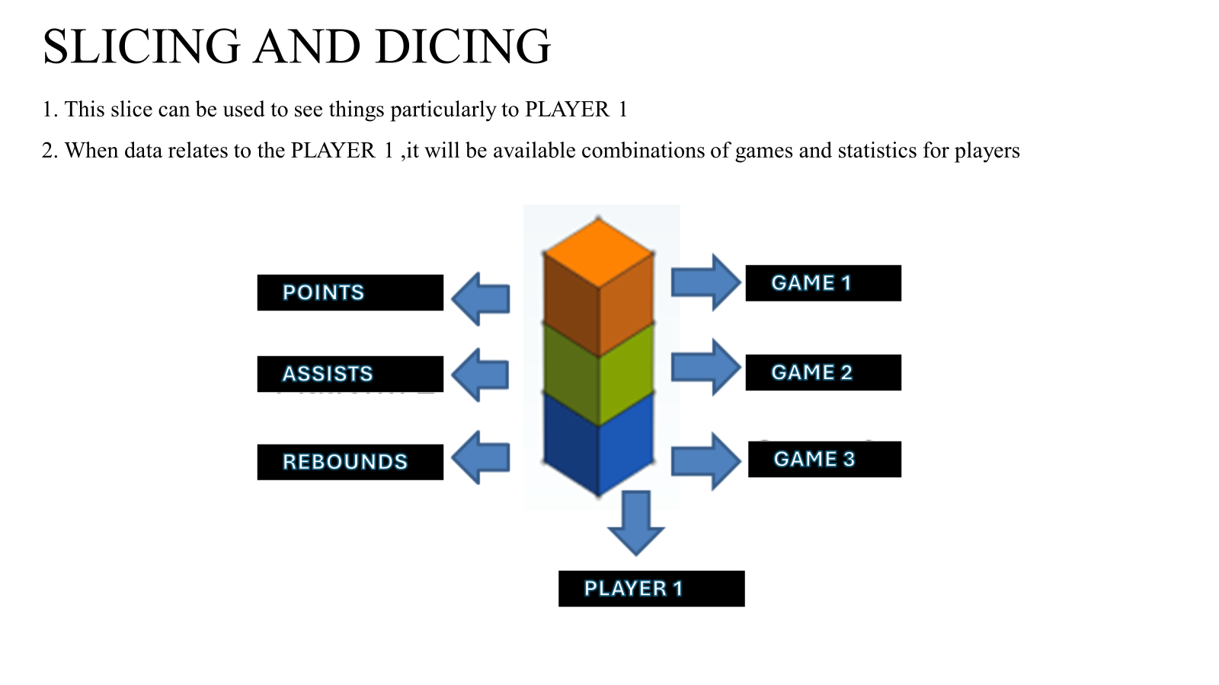
Notes:
An OLAP cube may also be considered an example of an “aggregate navigator”
No aggregate navigator algorithm and therefore no processing overhead - i.e., no SQL redirect & transformation. Navigate directly within the cube structure (e.g., drill-down)
For the power users

Slide 20
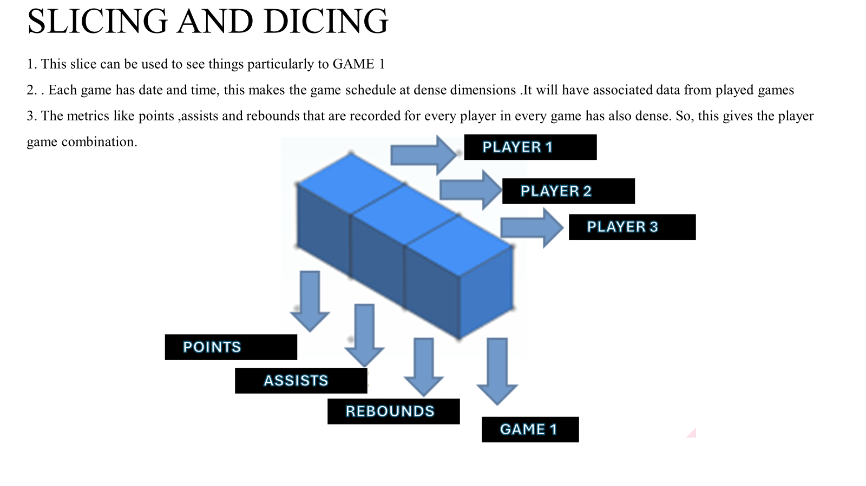

Slide 21
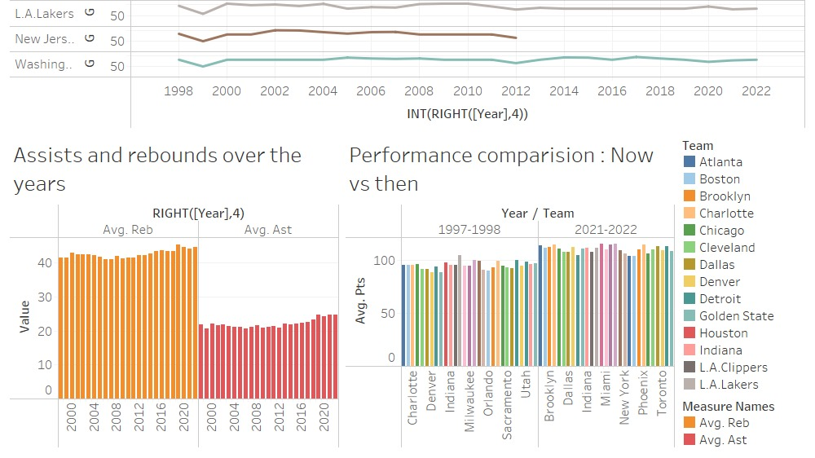
ANALYTICAL DASHBOARDS

Slide 22
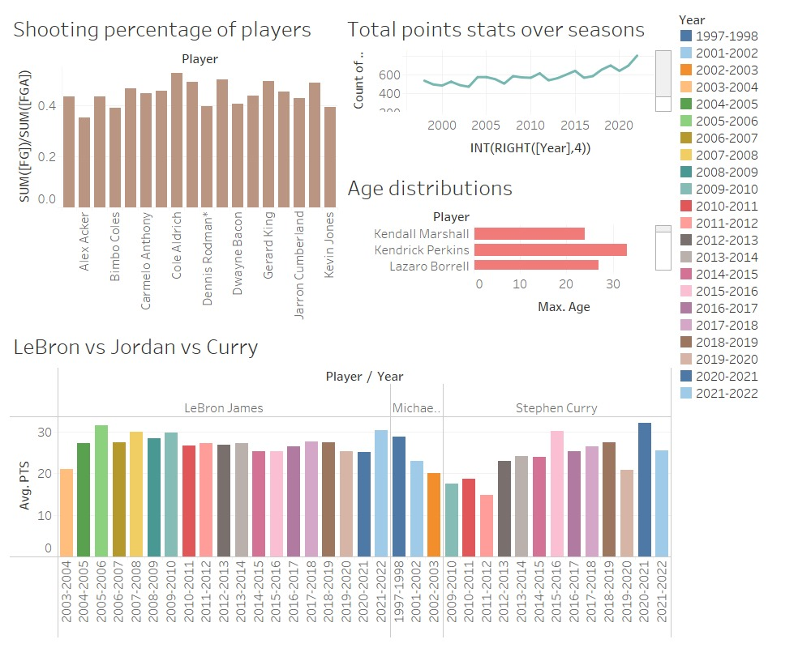

Slide 23
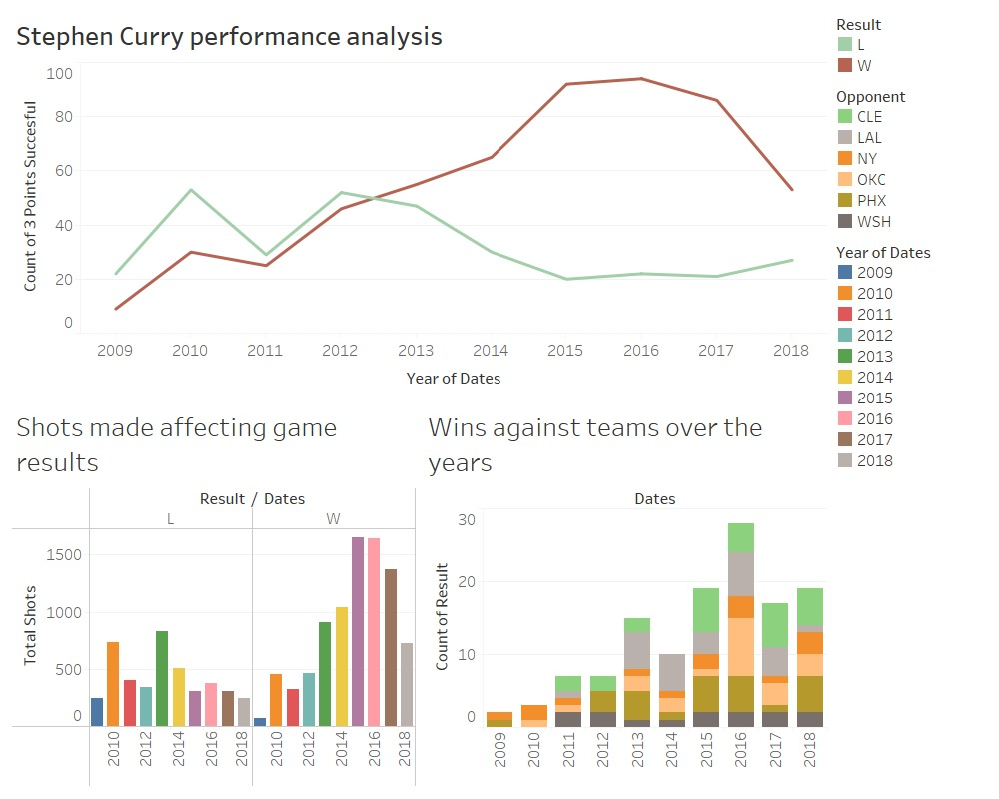

Slide 24
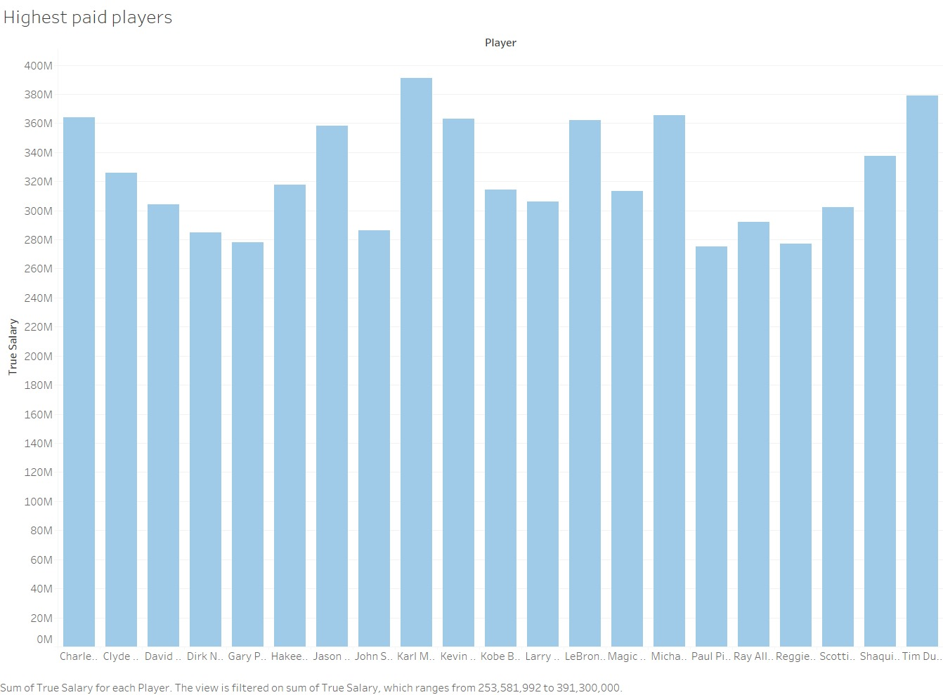

Slide 25
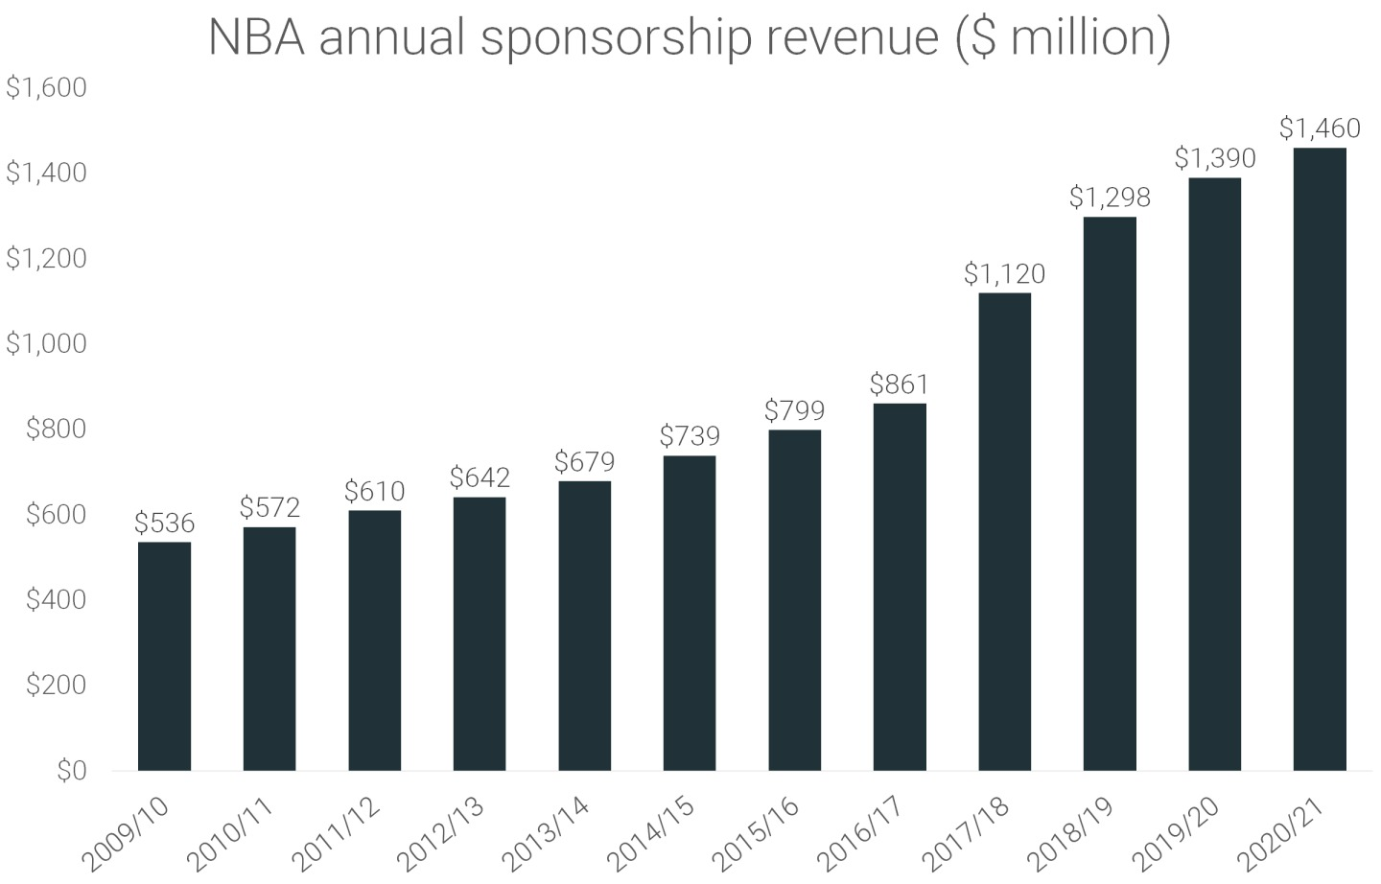
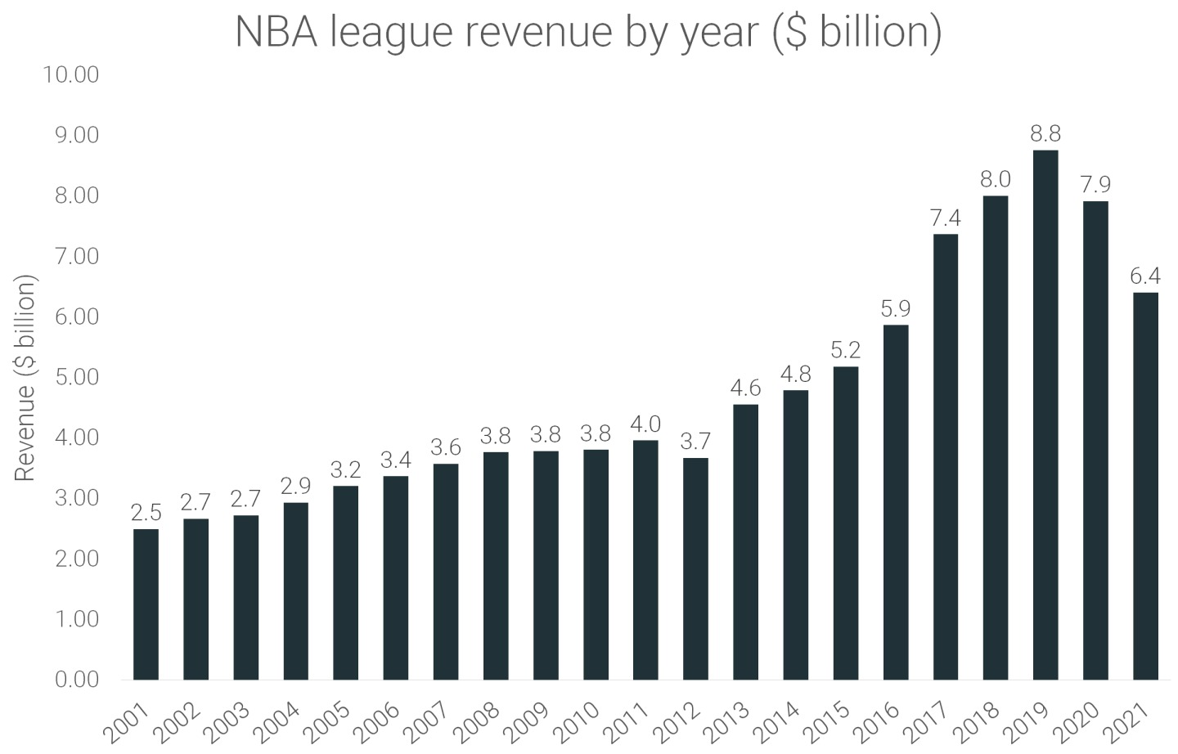
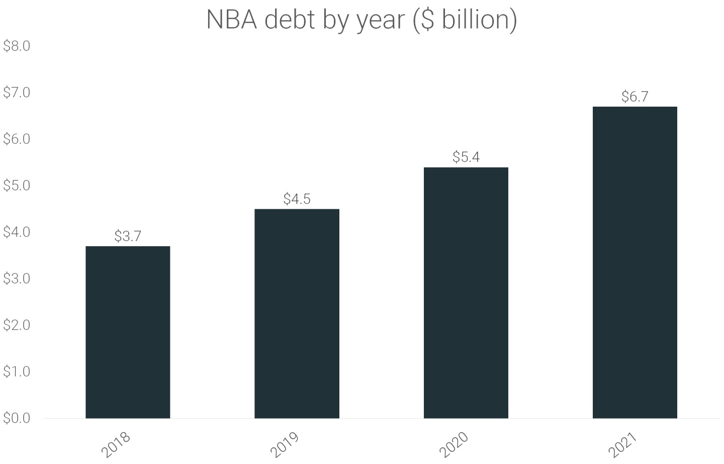
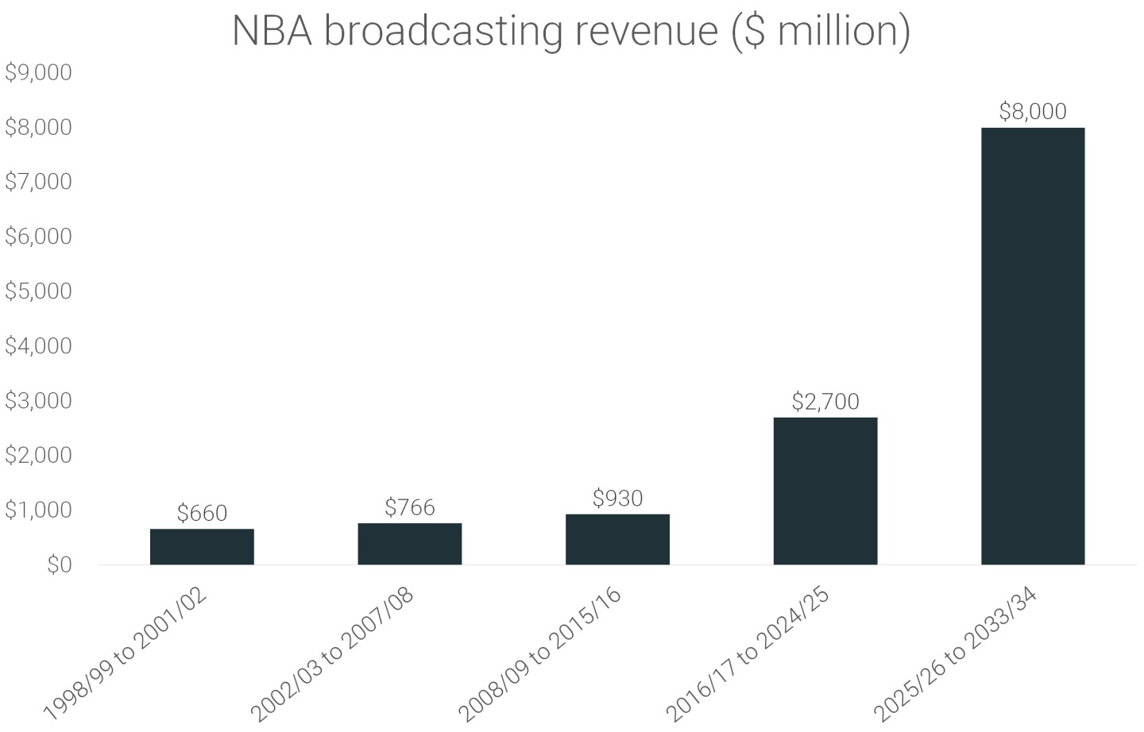

Slide 26
User & Task Analysis
Power Users:
Team Analysts, Sports statisticians
Value: They utilize detailed performance data to assess player efficiency, game strategies, and team dynamics.
Output Delivery: Advanced statistical analyses, custom reports on player and team performance, OLAP cubes for multi-dimensional data slicing.
Executives:
Franchise Owners, General Managers
Value: Risk factors are analysed, bicycle stationing values are taken.
Output Delivery: Executive dashboards summarizing financials, attendance, fan engagement; risk analysis reports; comprehensive OLAP analysis for decision support.
Operational user:
Scouts, Coaches, Medical Staff
Daily operational decisions such as player selection, training focus, injury prevention, and game-day decisions.
Output Delivery -Real-time dashboards with player health stats, game stats for immediate analysis, reports on player development, and injury reports.

Slide 27

References
https://github.com/swar/nba_api
https://www.kaggle.com/datasets/wyattowalsh/basketball
https://data.world/datasets/nba

Slide 28

THANK YOU

